Slide 1


Mojaloop deployment experience in Myanmar
(Hub Operator’s perspective)
PI - 18 OSS Community Meeting
27 April 2022
Pyae Phyo Lwin

Slide 2
Agenda
Preparation for Deployment
Lessons learned from FUT
Next steps
2

Slide 3
Preparation for Deployment

Slide 4
Hub Ops Team Preparation

Slide 5
Hub Operations Team Setup
Setting up organization structure
Preparation of JDs
Recruitment
Training

Slide 6
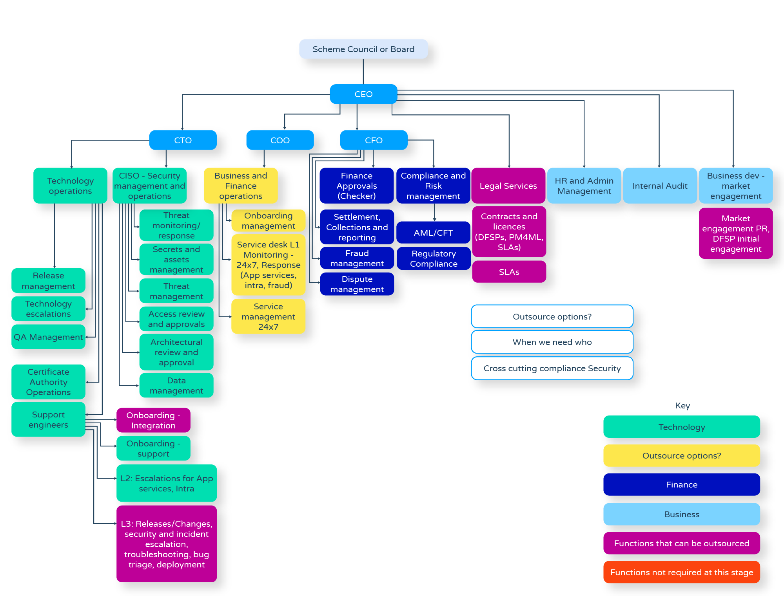


Slide 7
Preparation for Onboarding of DFSPs
Initial phase
Project kickoff meeting
Development
UAT & Go-live
Discuss business flows
Explain Mojaloop APIs
Map data fields
Produce specification doc
Develop core connector
Create test plans
Set up weekly calls
Set up VPN connection
Set DFSP users with PM4ML accounts
Provide training on PM4ML
Conduct integrated testing
Conduct end-to-end testing
Try out DFSP APIs

Slide 8
Onboarding Timeline
Wallet – From 1 to 4 months
MFI – From 2 to 4 months
Documents Preparation
Assessment form to collect basic information of wallets
API specification document (with final business flow, mapping, etc.)
Error message explanation
Transaction summary and detail reports (FUT)

Slide 9
Preparation for Settlement
Prepare Settlement process work flow
Arrange a meeting with DFSP to explain Settlement process
Support DFSP to open the liquidity account at Settlement bank
Request the contact information of DFSP
Create the user account in Document Management System for keeping the settlement reports
Open a communication channel with each DFSP as well as Settlement bank (Skype or Viber is most commonly used)

Slide 10
Preparation for Settlement
When a new environment is upgraded in Finance Portal (FP),
Pre-tasks
Prepare Finance Portal user list and role
Record DFSPs balances and reports
After-tasks
Update the balance and NDC as per recorded screenshots
Check if the report links are working properly
Smoke test on new environment

Slide 11
Preparation for Customer Service
Develop Support Service Workflow (SLA agreement, support flow diagram, support level etc.,)
Develop Dispute Management Process (Dispute principals, scenarios etc.,)
Prepare Dispute Report Specification and Format
Develop Risk Management document
Create Service Desk
Prepare Service Desk User Guide
Train DFSPs how to use Service Desk
Open communication channel with DFSPs (Skype)

Slide 12
Lessons Learned from FUT

Slide 13
Final status of FUT
Total Transactions - 336
Success - 317 transactions
Failed – 19 transactions
Insufficient liquidity
Certificate expiration
Wallet business rules (for example, inactive for 5 mins while a transaction is failed)
Insufficient balance error (Wallet has limited minimum balance of 1000Ks in the client’s wallet)
API issue

Slide 14
Lessons learned from onboarding
Failed transactions deduct money (loan or fees/charges or both)
Some wallet cannot show third-party error message and difficult to trace the root cause
VPN configuration issue due to the current situation in Myanmar
Some wallet account creation can be difficult and complicated

Slide 15
Lessons learned from settlement
Finance Portal
Need to analyze and finalize report format before development to avoid manual processes.
Need to check if DFSP liquidity account details are included in the settlement bank report.
Settlement bank must inform the hub operator if there are any changes in liquidity balance (adding or withdrawing).
Avoid deleting “Manager” role for user access. If there is no other user as “Manager”, then the permission need to be added via backend to reclaim the access.

Slide 16
Lessons learned from settlement
Liquidity Account
Proper Bank accounts of DFSP is important for in time settlement
DFSP emails for accessing reports
To limit maximum 3 email accounts from each DFSP

Slide 17
Lessons learned from customer service
Most issues are “Refund cases” and refund process must be clarified with each DFSP
Wallet Specifications
DFSPs need to know the knowledge of wallet specifications to avoid transaction failed state
Difficulties of cash in process
NDC (Net Debit Cap) issue
Insufficient liquidity balance
Bad Request issue
Certificate expired
Communication with Clients (MFIs)
Skype & Service Desk Portal

Slide 18
Next Steps

Slide 19
To be a more efficiently functioning Platform
Currently, only repayment use case. Disbursement and P2P use cases must be prioritized.
Report generation must be simplified with one click to push relevant reports to respective DFSPs as well as to settlement bank(s)
Document management system used by WynePay should be replaced by DFSP portal
API integration with Settlement bank(s)
Proper Dispute management system to solve dispute more efficiently

Slide 20
Thank You!!!

